Slide 1
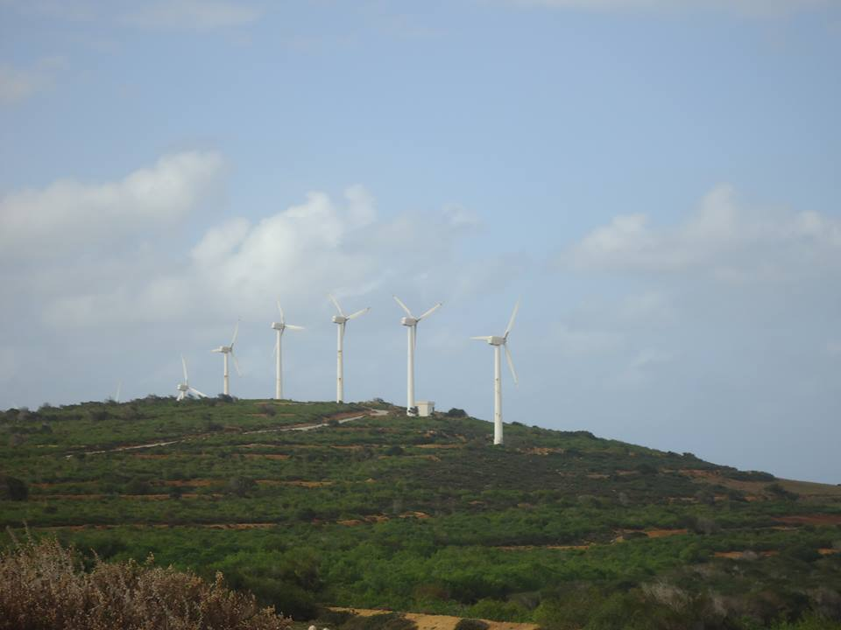
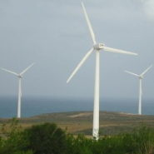

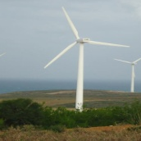
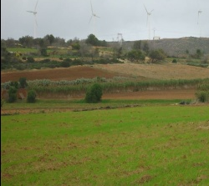
Beyond Nimbyism-the role of place attachment in explaining public responses toward the implementation of renewable energy projects: a wind energy case study
A master’s thesis
Submitted by Supervised by
Sahar CHTOUROU Pr. Abdelfattah TRIKI

Slide 2
Outline
Problematic and context
Research questions
Objectives
Literature review
Chapter one
Chapter two
Chapter three
Methodology
Results
Practical implications
Limitations and future perspectives

Slide 3
PROBLEMATIC
Controversial theme of renewable energy
Efforts made by:
Developed countries
Developing countries
United States
European United States
Japan …
Algeria
Kenya
Brazil …
National policies
Soderholm and Pettersen (2007)
Climate change mitigation
Diminishment of carbon gas emissions

Slide 4
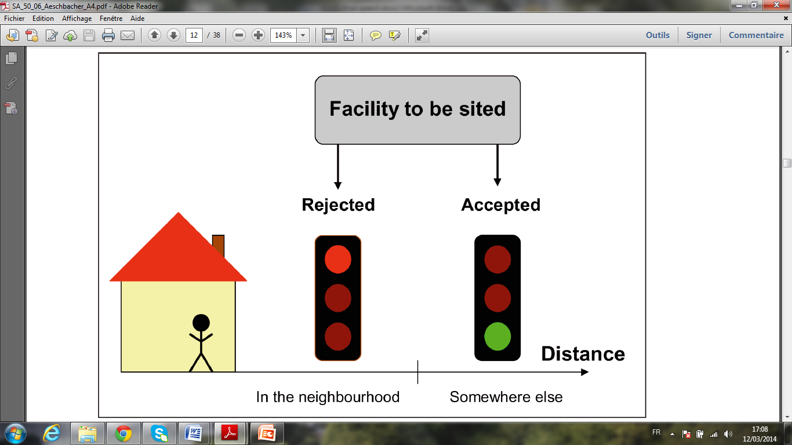
PROBLEMATIC
Distribution of acceptance and rejection of facilities by people holding a NIMBY attitude
Social acceptance
Aeschbacher & Stauffacher (2006)
Surveys conducted between the 80’s and the 90’s
CORNER STONE OF SUCCESS
Energy projects
New technologies
Public opinion: highly supportive of RES adoption
Once applied to the field, projects often end up being confronted to local opposition
Renewable energy technologies:
Wüstenhagen et al. (2007) ; Wolsink (2007)
Failed to meet the required attention
Understanding public acceptance requires much more than the mere comprehension of public opinion and necessities a deeper knowledge of the way in which attitudes are formed and shaped.
General public support
Social acceptance
Sauter & Watson (2007) ; Wüstenhagen et al.(2007)
“Not in my Backyard”
Oppositional tactic
Research is still on its primary phases
What is expected
Public acceptance
Toke (2005)
Efforts converge only to specific
technologies
Local resistance
A label for a spatial type of opposition
Del Río & Burguillo (2009) ; Llera et al.(2010)
What is found
Walker (1995) ; Heras-Saizarbitoria et al. (2011)

Slide 5
PROBLEMATIC
Alternative framework
Review of the PA literature:
Explanatory utility
Questioning
NIMBY
Empirical support
Academic disciplines
Contexts
Sociology
Recreation sciences
Human geography
Environmental psychology
-with the exception Debenedetti and his collegues’ (2014) study-
Setting for a new explanation
Parks and recreation landscapes
Protected areas
Neighborhoods and communities
Emotional bonds
Stedman (2002)
did not take into account the wider context within which the PA concept operates
Walker & Chapman
(2003)
Instead of limiting to
Mesch & Manor (1998)
did not address PA structure in a holistic way
Kyle et al. (2004)
Spatial closeness

Slide 6
RESEARCH QUESTIONS
OBJECTIVES
To deepen understandings of the role of place attachment , related-symbolic meanings and socio-economic variables in explaining public responses to renewable energy developments, against a backdrop of academic social science critique of the ‘NIMBY’ logic.
How can we explain local opposition while putting aside the logic of NIMBY syndrome?
How does place attachment contribute to explaining public responses toward proposed wind power developments?
To dig deep inside the PA structure (meaning and operational definition) and to develop a conceptual model that explores its role in the wider context of land use-changes.
Under which circumstances can PA lead to public acceptance?
What is the meaning of the PA concept within specific contexts of land-use changes?
Notes:
In order to fill the research gaps,
Moving to the objectives .. They were formulated as usual in a manner to respond each of

Slide 7
CHAPTER 1: Why opposition occurs? Answers from the
perspective of decision-making process
Conceptualizing social acceptance
acceptance of policies and technologies
by: the public, stakeholders and
policy makers
Socio-political acceptance
Community acceptance
Market acceptance
of: procedural justice, trust and distributional justice
by: consumers, investors
and intra-firms
Fig.1: The triangle of social acceptance of renewable energy innovation

Slide 8
CHAPTER 1:
Why opposition occurs?
Answers from the
perspective of decision-making process
The limitations to the use of public opinion polls
Further investigation is needed about beliefs on RE projects
as means for evaluating public attitudes
The planning literature
Justifications for public engagement in the process of decision making
PUS
The misunderstanding of general public advocacy toward the deployment of RES
Public
key conceptual insights from the PUS literature
Public opinion
Surveys have failed to adequately explain the nature and complexity of public perceptions
Logic of evolution of PUS: from a deficit model to more participatory approaches of public engagement
Public understanding of renewable energy
Ways for acheiving PURE

Slide 9
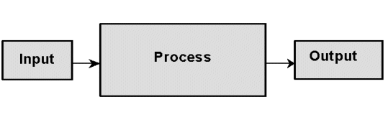
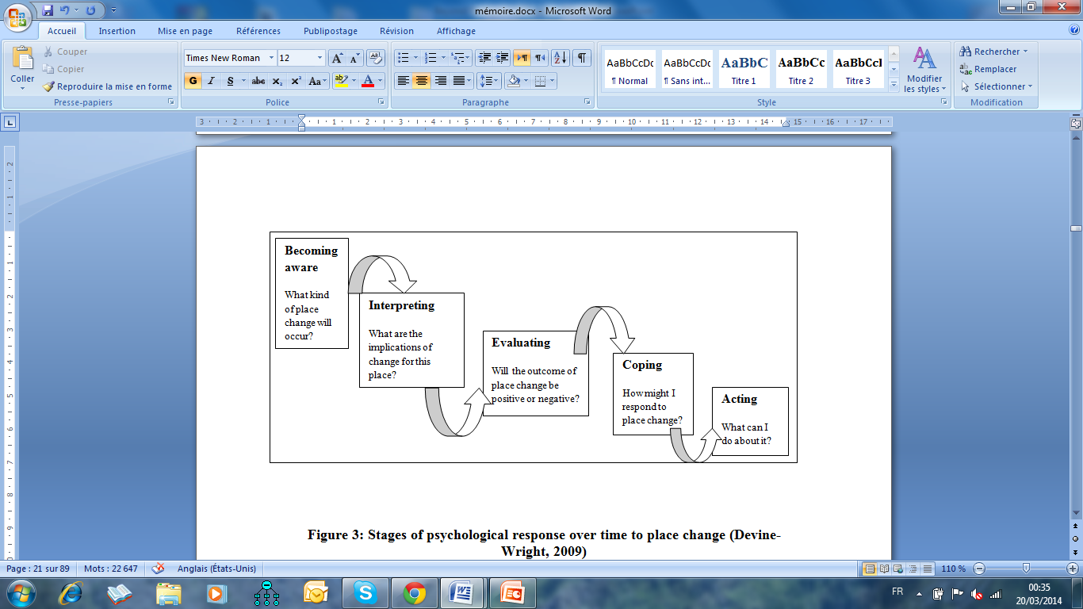
CHAPTER 2: Why opposition occurs? Answers from the
perspective of outcomes of development
McGrath (1964)
Combination between
Devine-Wright (2009)

Slide 10
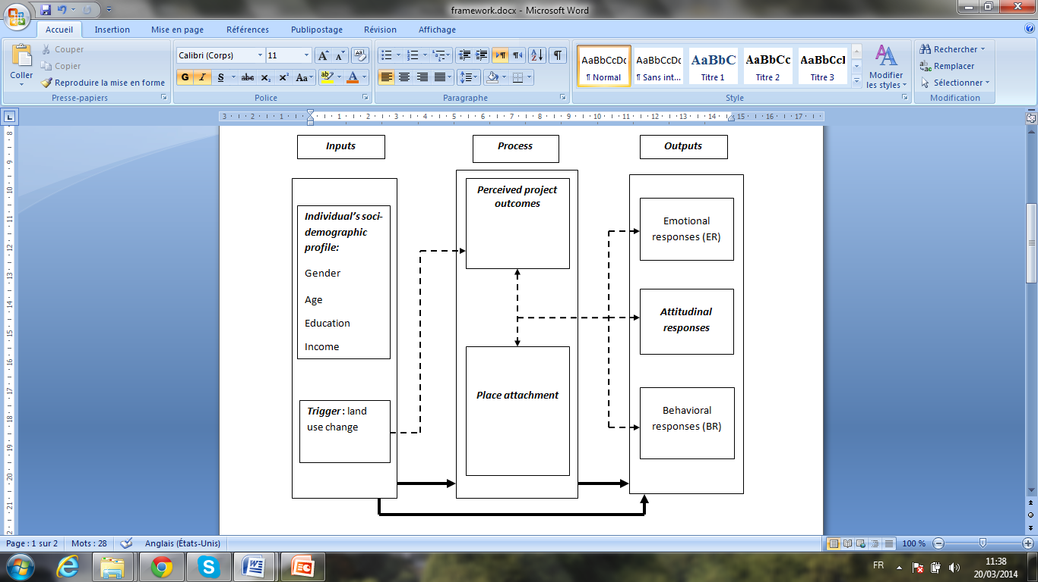
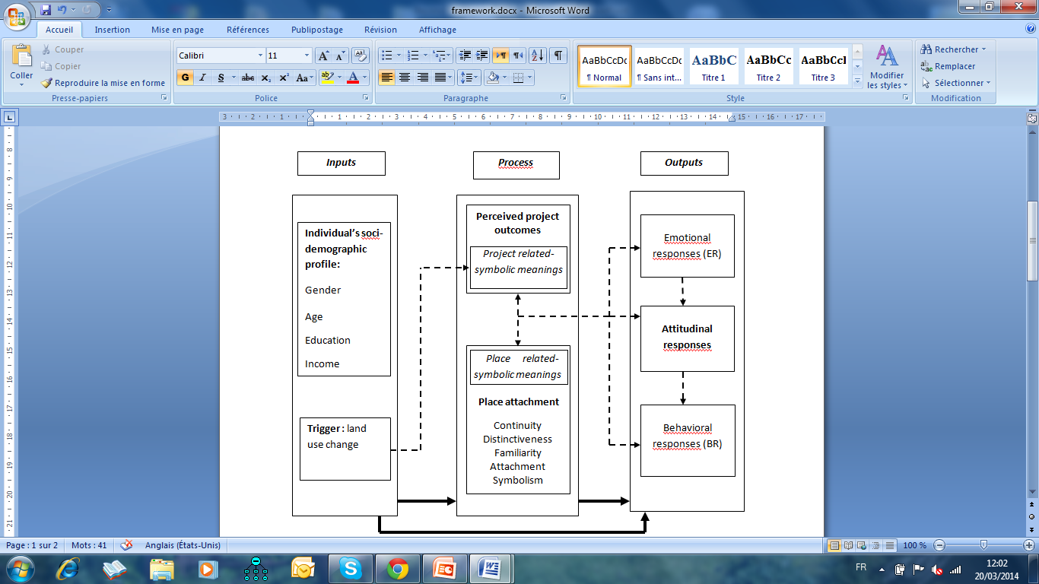
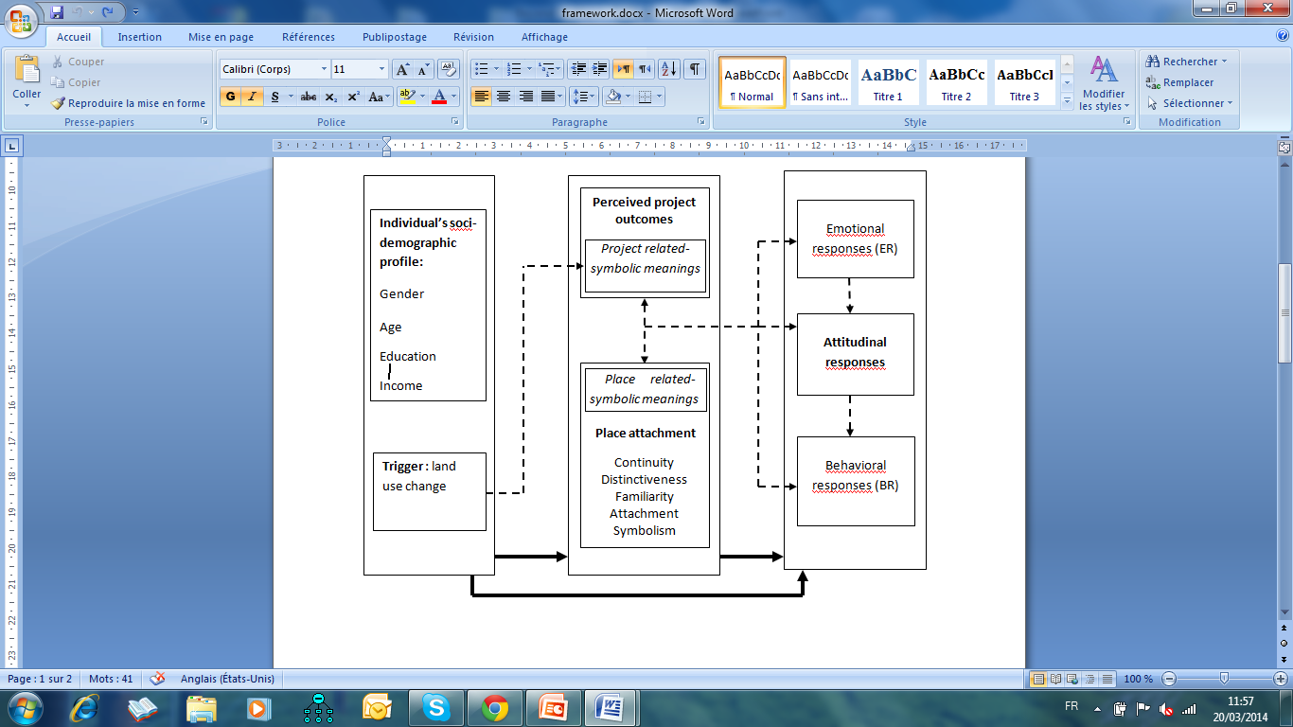
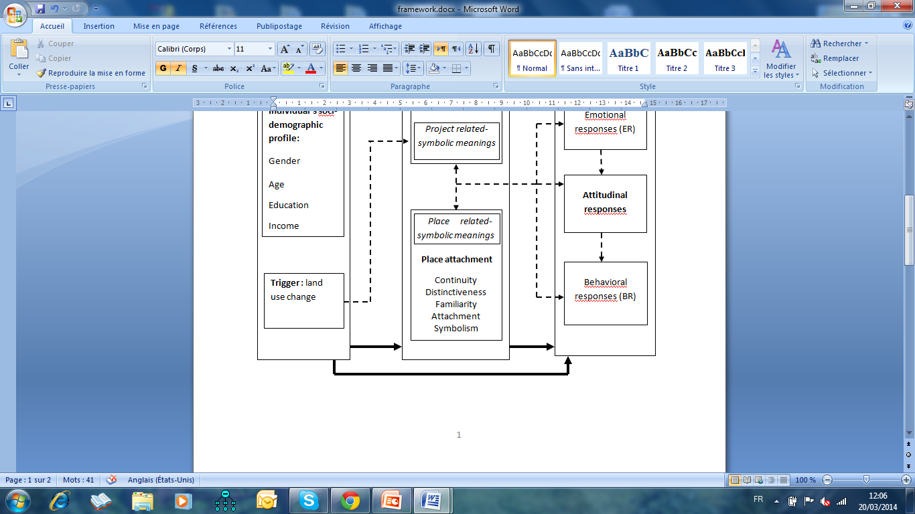
Fig. 2: The role of PA in predicting public responses to proposals for change as related to the success/failure of RE projects.
Favorable
Unfavorable
Positive
Negative
(yes)
Degree of matching
Supportive behaviors (local acceptance)
(no)
Place protective actions
(local opposition)
Denying or accepting change
Making sense of change
Acknowledgment
(Becoming aware)
Coping
Interpretation stage
Evaluation stage
Identification stage
Acting

Slide 11
CHAPTER 3: Review of the literatures on
and customer experience
place attachment
Tab1:
Classification of conceptual and operational definitions of PA as identified in the literature
Place dependence: one dimensional
Place identity: one dimensional
Place attachment: two dimensional Dim1:Place dependence Dim2:Place identity
Place attachment: three dimensional Dim1:Global attachment Dim2:Social attachment Dim3:Physical attachment
Sense of Place: one dimensional (7 items)
Place-related social identity: three dimensional Dim1:Social cohesion Dim2:Place satisfaction Dim3:Place identification
Sense of Place: one dimensional (6 items)
Place attachment: three dimensional Dim1:Place: social, physical Dim2:Person: individual, group Dim3:Process: affect, cognition, behavior
Place affect
Social bonding
familiarity, belongingness, rootedness

Slide 12
CHAPTER 3: Review of the literatures on place attachment
and
customer experience
Philosophical
investigations
Cognitive
science
Applied writings
on management
EXPERIMENTAL DIMENSIONS
Theoretical foundation for the PA construct
- as applied to a context of proposals for change -

Slide 13
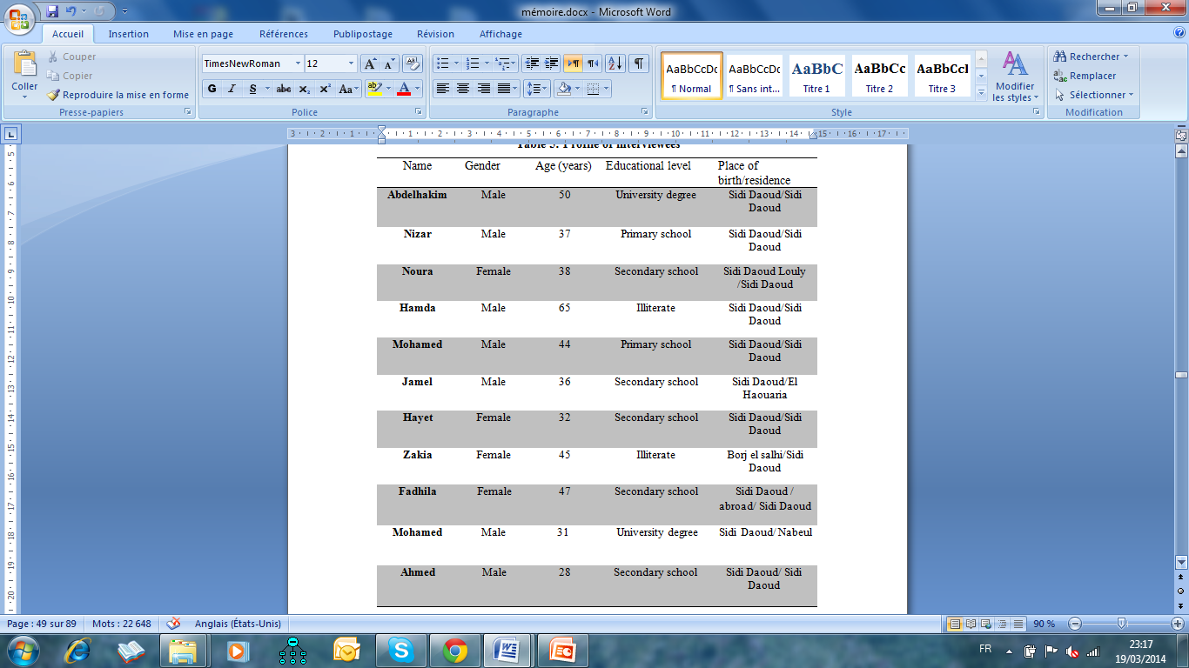
METHODOLOGY
First theme: Place attachment
Second theme: Perceived project outcomes
Third theme: attitudinal responses
Interview guide
The exploratory nature of the research
1:Continuity
2:distinctiveness
3:familiarity
4:attachment
5:symbolism
ABDUCTIVE LOGIC
Literature review
Fieldwork (case study)
QUALITATIVE METHODS OF INQUIRY
Choice justification: the classification is quite inclusive of all the sub dimensions of PA.
Teddy et al. (2008)
To generate valuable information across a sample of opinions.
To realize how locals construe meanings about their socio-physical environment.
Bryman (2004 )
Tape-recorded
Data collection method
Semi-structured interviews
Transcribed
Analyzed
Research technique
Content analysis

Slide 14
RESULTS
Attitudinal responses to proposals for change
indifference
positive
negative
The project was seen through different ‘lenses’
PPOs
quiet and
‘natural’ wealth
beneficial novelty
symbolic meanings (Place)
Strengthen
symbolic meanings (Project)
interrupt
PA
continuity distinctiveness familiarity attachment symbolism
Lack
of fit
local resistance
Good
fit
local acceptance
Project acceptance
symbolic meanings (Project)
symbolic meanings (Place)
(-)
(+)
‘industrialized’
noisy area
‘adressing internel issues’

Slide 15
RESULTS
Customer experience research angle:
The implementation of specific forms of place change
(RE projects)
sensory level
affect the sensory features of a place: favorable/unfavorable views, smells...
affective level
blur/keep alive past emotional experiences: inner feelings and affective relations to the setting.
social level
impact positively/negatively pre-lived relational experiences.
intellectual level
impact the cognitive processing of information.

Slide 16
RESULTS
literature on PA
1:continuity
2:distinctiveness
3:familiarity
4:attachment
5:symbolism
6: local/regional development
DS based–attachment experience:
the tendency of individuals from local communities to engage in projects aiming at improving the local economy, job creation and increasing society’s living standards merely by making rational use of the current features of the area.
a set of experienced ties acquired over time through continual interactions with a particular place. Person-place bonding arises from personal involvement at different levels of experience in which individuals construe meaning about their socio-physical environment.
customer experience literature
the active participation of local residents’ in the construction process of any sort of projects of type.
land-use change

Slide 17
PRACTICAL IMPLICATIONS
McLachlan’s (2009) claim :
Development companies proposing RE technologies need to place more emphasis on place-person bondings and associated symbolic meanings
Project managers need to :
Scan the external environment
Mentally warn managers to the particular aspects of locations that require to be taken into consideration when executing plans
better manage land–use changes
increase chances of social acceptance among affected community members
Make sure that congruent outcomes are transmitted to local residents
conveying information
social media
interpersonal connections
Suitable RE developments
Suitable contexts
Support and add value to the locals’ experiences
creating favorable experiences during the stages of the project
development

Slide 18
LIMITATIONS AND FUTURE RESEARCH PERSPECTIVES
The process of collecting data
precise point in time
temporal ordering of public responses:
to adopt a longitudinal design
cannot be evidenced
might be less linear than presented
Causal relationships
cannot be evidenced from qualitative research techniques
to apply quantitative techniques
Eg. Structural equation models
Moderating factor
Other factors
perceived project outcomes (PPOs)
procedural justice in decision making Gross, (2007)
public trust in stakeholders
Eg. Developers, opposition groups
Walker et al. (2010)

Slide 19
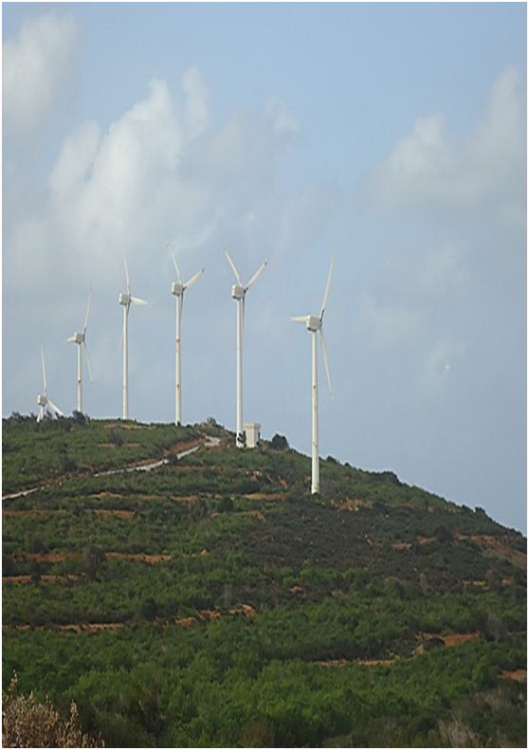
THANK YOU
FOR
YOUR
ATTENTION

