Slide 1




2nd International Biannual
Social Business@Anadolu Conference
Germans vs. Others on Environmental Issues.
How different and how similar are they?
Hristo Kutin
Elif Kocagöz
Fritz und Maria Hofmann-Stiftung
10-13 June2015, Rixos, Eskisehir, Turkey

Slide 2
Content
Introduction
Research & Results
Conclusion
10-13 Juni 2015, Rixos, Eskisehir, Turkey

Slide 3

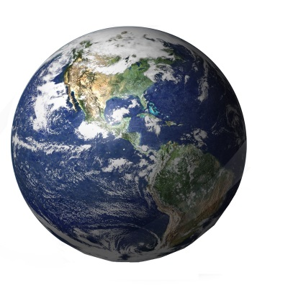




How much is enough?
Currently we need 1.5 Earths
to provide our resources and store the waste.
1
1
We would need 4.4 Earths, if every one consumed like in the USA.
1.Sources in the backup slide.
10-13 Juni 2015, Rixos, Eskisehir, Turkey

Slide 4
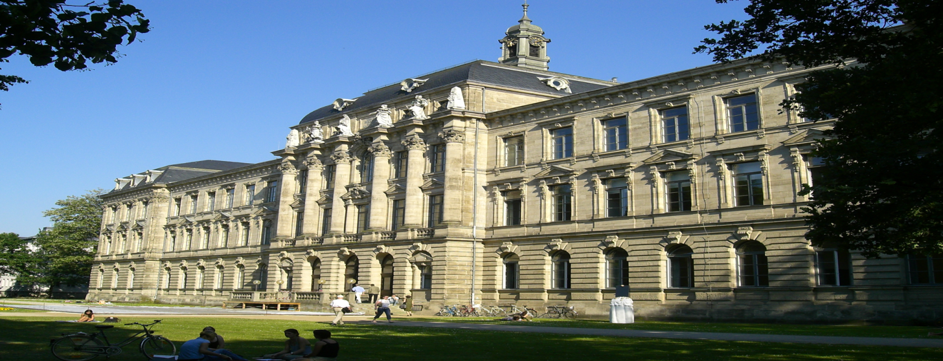
Research
Aimed to find out the similarities as well as the differences that Germans and other country nationals display on some environment-related topics
Sample: 151 Students/Graduates of the Master Program “Development Economics and International Studies” at Friedrich-Alexander University of Erlangen-Nürnberg
Online Survey: August 2014
10-13 Juni 2015, Rixos, Eskisehir, Turkey

Slide 5
Findings
 |  | f | % |  |  | f | %
Gender | Male | 50 | 46 | Age | 21-25 years old | 54 | 49.50
 |  |  |  |  | 26-34 years old | 55 | 50.50
 | Female | 59 | 54
Marital Status | Single | 75 | 69 | Income | up to 600 | 36 | 33
 | Married | 8 | 7 |  | 601-1100 | 41 | 38
 | Living with partner | 20 | 18 |  | 1101 and over | 32 | 29
 | Other | 6 | 6
 |  |  |  | Environmental NPO Membership | Yes | 8 | 7
Employment | Only student | 26 | 23
 |  |  |  |  | No | 101 | 93
 | Student & intern/part time job | 36 | 33
 | Full time job | 38 | 35 | Donation to an environmental cause | Yes | 41 | 38
 | Self employed | 7 | 6 |  | No | 68 | 62
 | Other | 3 | 3
10-13 Juni 2015, Rixos, Eskisehir, Turkey

Slide 6
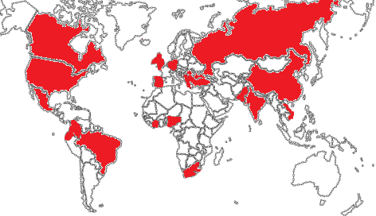
Findings
24 nationalities: 38 Germans and 71 other country nationals (Albania-1, Brazil-1, Britain-England-2, Bulgaria-2, Canada-2, China-12, Colombia-4, Croatia-2, Ecuador-1, Ghana-1, India-2, Mexico-2, Nigeria-3, Pakistan-3, Romania-5, Russia-14, South Africa-3, Spain-1, Turkey-4, Ukraine-1, USA-4, Vietnam-1)
10-13 Juni 2015, Rixos, Eskisehir, Turkey

Slide 7
First associations with the word environment
 |  | E01 | E02 | E03 | E04 | E05 | E06 | E07 | E08 | E09 | E10
German | f | 0¹ | 8 | 0 | 1 | 13² | 7 | 2 | 5 | 2 | 2
 | % in group | 0 | 21 | 0 | 3 | 34 | 18 | 5 | 13 | 5 | 5
Others | f | 11 | 15 | 0 | 2 | 12 | 16 | 6 | 6 | 0 | 3
 | % in group | 15 | 21 | 0 | 3 | 17 | 23 | 8 | 8 | 0 | 4
Total* | f | 11 | 23 | 0 | 3 | 25 | 23 | 8 | 11 | 2 | 5
E01 Pollution in towns and cities E02 Green and pleasant landscapes E03 Earthquakes, floods and other natural disasters E04 Man-made disasters such as oil spills, industrial accidents E05 Climate change E06 Protecting nature E07 The state of the environment our children will inherit E08 The quality of life where you live E09 Using up natural resources E10 Others |  |  |  |  |  |  |  |  | ¹Chi-square:6.548, df:1, Sig.:0.010 ²Chi-square:4.196, df:1, Sig.:0.041 *Total is not equal to 109 while a few responded with two options.
Top 3 for all:
Climate change 23%
Protecting nature 21%
Pleasant landscapes 21%
No one
Earthquakes, floods, natural disasters
10-13 Juni 2015, Rixos, Eskisehir, Turkey

Slide 8
Environmental issues respondents most worry about
Top 3 for all:
Environmental pollution 48%
Climate change 43%
Depletion of natural resources 38%
Least for all
Impact of current transport modes 2%
 |  | W 01 | W 02 | W 03 | W 04 | W 05 | W 06 | W 07 |  | W 08 | W 09 | W 10 | W 11 | W 12 | W 13
German | f | 18¹ | 14 | 12 | 15 | 7 | 2 | 8 |  | 15 | 2 | 4 | 12² | 1 | 1
 | % | 47 | 37 | 32 | 39 | 18 | 5 | 21 |  | 39 | 5 | 11 | 32 | 3 | 1
Others | f | 18 | 27 | 27 | 38 | 22 | 11 | 17 |  | 31 | 11 | 7 | 3 | 1 | -
 | % | 25 | 38 | 38 | 54 | 31 | 15 | 24 |  | 44 | 15 | 10 | 4 | 1 | -
Total | f | 36 | 41 | 39 | 53 | 29 | 13 | 25 |  | 46 | 13 | 11 | 15 | 2 | 1
W01 Our consumption habits W02 Depletion of natural resources W03Urban problems (traffic, pollution, lack of green spaces) W04 Environmental pollution W05 The impact of chemicals used in everyday products on health W06 Use of genetically modified organisms in farming W07 Loss in biodiversity |  |  |  |  |  |  |  |  | W08 Climate change W09 Man-made disasters W10 Natural disasters (earthquakes, floods, etc.) W11 Growing waste W12 Impact of current transport modes on the environment W13 Others ¹ Chi-square:5.424, df:1, Sig.:0.020 ² Chi-square:15.606, df:1, Sig.:0.000
10-13 Juni 2015, Rixos, Eskisehir, Turkey

Slide 9
Level of Information (on given environmental issues)
Top 3 for all:
Climate change, Urban problems, Natural disasters
Least for all:
Health impact of chemical used in everyday products
The use of GMO in farming
 | f | In01 | In02 | In03 | In04 | In05 | In06 | In07 | In08 | In09 | In10 | In11 | In12 | In13
German | 38 | 3,58 | 3,29 | 3,53 | 3,18 | 2,63 | 2,53 | 2,97¹ | 3,74² | 3,42 | 3,66³ | 3,24 | 3,24 | 3,24
Others | 71 | 3,25 | 2,99 | 3,41 | 3,23 | 2,80 | 2,55 | 2,52 | 3,37 | 3,10 | 3,28 | 2,89 | 3,00 | 3,17
Total | 109 | 3,36 | 3,09 | 3,45 | 3,21 | 2,74 | 2,54 | 2,67 | 3,49 | 3,21 | 3,41 | 3,00 | 3,08 | 3,19
In01 Our consumption habits In02 Depletion of natural resources In03 Urban problems (traffic jams, pollution, lack of green spaces, etc.) In04 Environmental pollution (Air, Noise, Water, Agricultural etc.) In05 The impact on our health of chemicals used in everyday products In06 The use of genetically modified organisms in farming In07 Loss in biodiversity (extinction of species, loss of wildlife and habitats) |  |  |  |  |  |  | In08 Climate change In09 Man-made disasters (major oil spills or industrial accidents, etc.) In10 Natural disasters (earthquakes. floods. etc.) In11 Growing waste In12 Impact of current transport modes (more cars. more motorways. more air traffic. etc.) In13 In general how informed do you feel about environmental issues? ¹ t:-2.321, df:107, Sig.:0.022 ² t:-2.083, df:107, Sig.:0.040 ³ t:-2.030, df:107, Sig.:0.045
10-13 Juni 2015, Rixos, Eskisehir, Turkey

Slide 10
Main sources of information
Top 3 for all:
Internet 87%
Social Media 46%
TV news 37%
Least for all:
Specialized events (conferences, fairs, exhibitions, etc.) 7%
Books 4%
 |  | SI 01 | SI 02 | SI 03 | SI 04 | SI 05 | SI 06 | SI 07 | SI 08 | SI 09 | SI 10 | SI 11 | SI 12
German | f | 14 | 5 | 12 | 13 | 7 | 10* | 1 | 35 | 11 | 3 | 1 | 1
 | % | 37 | 13 | 32 | 34 | 18 | 26 | 3 | 92 | 29 | 8 | 3 | 3
Others | f | 18 | 8 | 28 | 20 | 11 | 40 | 3 | 60 | 15 | 4 | 2 | 2
 | % | 25 | 11 | 39 | 28 | 15 | 56 | 4 | 85 | 21 | 6 | 3 | 3
Total | f | 32 | 13 | 40 | 33 | 18 | 50 | 4 | 95 | 26 | 7 | 3 | 3
Si01 Newspapers Si02 Magazines Si03 Television news Si04 Films and documentaries on television Si05 Conversations with relatives\ family\ friends\ neighbors\ colleagues Si06 Social Media (Facebook, Twitter) Si07 Books |  |  |  |  |  |  | Si08 The Internet Si09 Publications\ brochures\ information and material Si10 Events (conferences, fairs\ exhibitions, festivals, etc.) Si11 I am not interested in the environment Si12 Others * Chi-square:8.985, df:1, Sig.:0.003
10-13 Juni 2015, Rixos, Eskisehir, Turkey

Slide 11
Trust
Top 3 for all:
Non profit organizations 70%
Scientists 65%
International organization 55%
Least for all:
Governments 4%
Companies 3% and Television 3%
 |  | TR 01 | TR 02 | TR 03 | TR 04 | TR 05 | TR 06 | TR 07 | TR 08 | TR 09 | TR 10 | TR 11
German | f | 0 | 21 | 28 | 0 | 4 | 13 | 28 | 0* | 2 | 4 | 3
 | % | 0 | 55 | 74 | 0 | 11 | 34 | 74 | 0 | 5 | 11 | 8
Others | f | 4 | 39 | 48 | 3 | 3 | 25 | 43 | 11 | 1 | 5 | 9
 | % | 6 | 55 | 68 | 4 | 4 | 35 | 61 | 15 | 1 | 7 | 13
Total** | f | 4 | 60 | 76 | 3 | 7 | 38 | 71 | 11 | 3 | 9 | 12
Tr01 Governments Tr02 International organizations (United Nations, etc.) Tr03 Nonprofit organizations (Greenpeace, World Wildlife Fund, etc.) Tr04 Companies Tr05 Political parties standing for environment (Greens, etc.) Tr06 Consumer associations and other citizens’ organizations |  |  |  |  |  |  | Tr07 Scientist Tr08 Relatives\ family\ neighbors\ friends\ colleagues Tr09 Television Tr10 Newspapers Tr11 None of them Tr12 Others * Chi-square:6.548, df:1, Sig.:0.010 **Participants asked to indicate three options.
10-13 Juni 2015, Rixos, Eskisehir, Turkey

Slide 12
Responsibility
 | f | Res01 | Res02 | Res03 | Res04
German | 38 | 4.47 | 4.18 | 4.21 | 4.18*
Others | 71 | 4.25 | 3.96 | 4.11 | 4.55
Res01 As an individual, I can play a role in protecting the environment. Res02 Corporations and industry should be mainly responsible for protecting the environment. Res03 Governments should be mainly responsible for protecting the environment. Res04 Citizens of the world should be mainly responsible for protecting the environment. 1:Strongly disagree-5:Strongly agree, * t:2.482, df:107, Sig.:0.015
10-13 Juni 2015, Rixos, Eskisehir, Turkey

Slide 13
Most effective ways for tackling environmental problems
Top 3 for all:
Change consumption habits 43%
More information on env. issues 16%
Financial incentives to industry 12%
Least for all:
Introducing heavier fines for offenders 4%
 |  | SE01 | SE02 | SE03 | SE04 |  | SE05 | SE06 | SE07 | SE08
German | f | 7 | 1 | 12 | 7* |  | 2 | 4 | 3 | 1
 | % | 18 | 3 | 32 | 18 |  | 5 | 11 | 8 | 3
Others | f | 10 | 4 | 35 | 4 |  | 7 | 9 | 1 | 1
 | % | 14 | 6 | 49 | 6 |  | 10 | 13 | 1 | 1
Total** | f | 17 | 5 | 47 | 11 |  | 9 | 13 | 4 | 2
SE01 Providing more information on environmental issues SE02 Ensuring better enforcement of existing environmental legislation SE03 People must change their consumption habits in a sustainable and environmentally friendly way SE04 Introducing and increasing taxation on environmentally damaging activities |  |  |  |  |  | SE05 Introducing stricter environmental legislation SE06 Offering higher financial incentives to industry, commerce and to citizens who protect the environment SE07 Introducing heavier fines for offenders SE08 Other *Chi-square:4.461, df:1, Sig.:0.035 **One invalid case, thus not equal to 109.
10-13 Juni 2015, Rixos, Eskisehir, Turkey

Slide 14
Top priorities to protect the environment
 |  | PR01 | PR02 | PR03 | PR04 | PR05 |  | PR06 | PR07 | PR08 | PR09 | PR10
German | f | 23 | 2 | 12 | 17¹ | 18² |  | 19 | 11³ | 13 | 1 | 0
 | % | 61 | 5 | 32 | 45 | 47 |  | 50 | 29 | 34 | 3 | 0
Others | f | 37 | 12 | 33 | 48 | 19 |  | 34 | 8 | 20 | 5 | 3
 | % | 52 | 17 | 46 | 68 | 27 |  | 48 | 11 | 28 | 7 | 4
Total | f | 60 | 14 | 45 | 65 | 37 |  | 53 | 19 | 33 | 6 | 3
PR01 Use public transport as much as possible not own car PR02 Replace your car with a more energy efficient one, even if it is smaller or more expensive PR03 Purchase eco- friendly products for your daily needs PR04 Sort waste so that it can be recycled PR05 Reduce waste by, for example, buying bigger sizes |  |  |  |  |  |  | PR06 Reduce your home energy consumption (electricity, heating, household appliances) PR07 Consider environmental aspects in large expenditures PR08 Buy more local products PR09 Pay a little more in taxes to help protect the environment ¹ Chi-square:5.378, df:1, Sig.:0.020 ² Chi-square:4.688, df:1, Sig.:0.030 ³ Chi-square:5.376, df:1, Sig.:0.020
Top 3 for all:
Sort waste to be recycled 19%
Use public transport 18%
Reduce home energy consumption 16%
Least for all:
Pay a little more in taxes to help protect the environment 2%
10-13 Juni 2015, Rixos, Eskisehir, Turkey

Slide 15
Activities performed for environmental reasons during the last month
Top 3 for all:
Separated waste 21%
Chosen an eco friendly way of travel 17%
Reduced energy consumption 15%
Least for all:
Bought environmentally friendly products (with eco label) 8%
 |  | EB01 | EB02 | EB03 | EB04 | EB05 | EB06 | EB07 | EB08
German | f | 26* | 20 | 28 | 15 | 23 | 12 | 13 | 2
 | % | 68 | 53 | 74 | 39 | 61 | 32 | 34 | 5
Others | f | 33 | 31 | 46 | 23 | 30 | 17 | 24 | 3
 | % | 46 | 44 | 65 | 32 | 42 | 24 | 34 | 4
Total | f | 59 | 51 | 74 | 38 | 53 | 29 | 37 | 5
EB01 Chosen an environmentally friendly way of traveling EB02 Reduced the consumption of disposable items (for example plastic bags, certain kind of packaging) EB03 Separated most of your waste for recycling EB04 Cut down your water |  |  |  |  | EB05 Cut down your energy consumption EB06 Bought environmentally friendly products marked with an environmental label EB07 Chosen locally produced products or groceries EB08 I have done nothing * Chi-square:4.800, df:1, Sig.:0.028
10-13 Juni 2015, Rixos, Eskisehir, Turkey

Slide 16
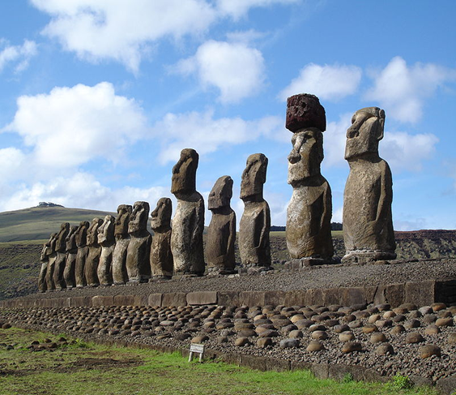
Conclusions
This study found some differences and similarities between German students and other country nationals.
There should be differences in the approaches, of the actors facilitating awareness and change towards a more sustainable environmental behavior.
Understanding the background of
people’s actions is crucial.
Companies
Policy makers
Civil society actors
10-13 Juni 2015, Rixos, Eskisehir, Turkey

Slide 17
Thank you Contact: Hristo Kutin: hristo_kutin@yahoo.com Elif Kocagöz: elifsayin@yahoo.com
10-13 Juni 2015, Rixos, Eskisehir, Turkey

Slide 18
References
Global Footprint Network, Oct, 2010: Ecological Footprint Atlas 2010.

